Slide 1
A Comparison of Voronoi Fracturing in Vulkan and OpenGL
By Samuel Lloyd

Slide 2
Context
As destruction effects in virtual entertainment have grown in usage, complexity, and scale, the need for performance has grown in tandem A commonly used algorithm for destruction is Voronoi fracturing, where a mesh is sliced against a generated Voronoi diagram.
Voronoi is a well research algorithm, that has already been well optimised. However, there is a constant demand for performance in applications such as game engines where Voronoi is commonly implemented.

Slide 3
Context
There is a lack of research on the graphical API that best suites Voronoi, such as OpenGL or Vulkan.
Graphics APIs can differ in the performance they offer, due to differing levels of control, and what GPU architecture they were designed for.
As a result of this, choosing the right graphical API can offer significant performance gains.

Slide 4
Justification
Optimising Voronoi for the correct Graphical API will offer clearer insight into the correct API to use when building an application that involves Voronoi.
This could benefit those with lower end hardware, as it could potentially lower the hardware barrier of applications that utilise Voronoi if they are more performant, and benefit the education sector when teaching about which API has more modern relevance.

Slide 5
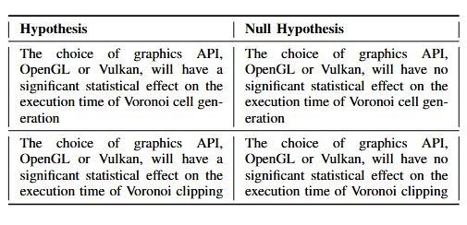
Question and Hypothesis
From this, the research question can be concluded as:
How does the execution time of OpenGL compare to Vulkan for a 3D Voronoi fracturing of a mesh?
And from this, we can derive the hypothesises

Slide 6
Lit results
Vulkan will perform better than OpenGL on modern GPUs, but OpenGL could perform better on older GPUs.
Constrained Delaunay triangulation will be used due to its efficiency O(n^2) and its ability to retain the shape of a polygon on triangulation, unlike Delaunay. This is needed to tetrahedralise the mesh for clipping, as tetrahedrons are needed to clip against
Poisson sampling will be used as it is optimised, and will ensure a set distance between points, which is important as points being too close could result artefacting due to floating point errors
There isn’t any research that explicitly compares Vulkan and OpenGL in Voronoi.

Slide 7
Method
An application for running a test of a Voronoi fracture on a 3D mesh has been created.
This utilises a bridge interface between the two APIs, ensuring that to use a feature on one API both APIs must have implemented it. This reduced bias as it ensured each API was implemented with a similar level of competence.

Slide 8
Method
To solve the research question, point set sizes from 2-100 have been test 145 times, as G*Power calculated that as the needed sample size.
The time has been recorded for the cell generation and cell clipping stages. Recording started at compute shader dispatch, and ended after the fence had signalled completion. This left out pre-processing and data buffering as that is not what was being tested.

Slide 9
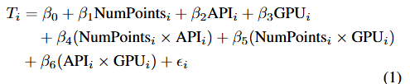
Method
After all sets have been recorded, the mean of each point set size was calculated, and used to create a two lineplots, one for generation, one for clipping.
A multiple linear regression test was performed twice, one for generation, one for clipping, with this formula:

Slide 10
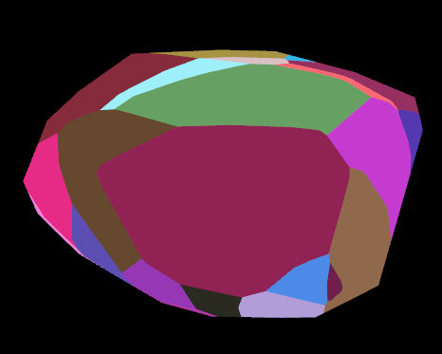
Implementation

Slide 11
Quality Assurance
Polarity testing using unit test have been performed, helping to test that the program was functioning, and how well it responded to unexpected inputs.
Assert statements have been used where appropriate to improve maintainability.
User expectation testing has been carried out, to ensure the fracturing looks visually correct
Smoke test on build to ensure everything runs correctly

Slide 12
Legal
Doesn’t violate GDPR.
Voronoi diagrams and Voronoi clipping are in the public domain.
Vulkan and OpenGL are in the public domain, however the implementations are not. However, as we don’t modify the drivers, this does not apply.

Slide 13
Social
Could lower the hardware barrier for applications that use Voronoi. This would increase accessibility.
Could shift the development trends if a significant performance advantage is shown by one of the API. This could result in increased hiring for that API, and a change in the educational priority's.

Slide 14
Ethical
Approved as low risk 14 as it does not violate any of the ethical concerns on the ethics checklist such as involving any participants or personal data or violating GDPR.
The accuracy and transparency of recorded results are critical as misleading results could negatively influence developer decisions. Actions have been taken to ensure this by clearly stating the limitations of this research and performing tests to ensure the quality of this experiment.
This project also takes care to not make any claims beyond the scope of this experiment, following the BCS code of practice.
Additionally, this work aims to minimise bias by ensuring equivalent implementations of Vulkan and OpenGL, so that any trends shown are due to the API’s design rather than outside factors like implementation. However, a complete removal of bias from this paper was not possible due to hard to control factors like temperature which can lead to throttling, or hardware specific optimisations that remained out of the experiments control.

Slide 15
Professional
Adheres to the bcs code of conduct of not claiming a level of competence one does not possess by stating results have not been tested on a wide variety of machines.
Follows Nuremburg code by providing research which will only benefit society, which this paper does by conducting research to clarify the more optimised API for Voronoi destruction.

Slide 16
Sustainability
Whilst improved execution time can lead to reduced energy consumption, it does not guarantee it. Modern GPU's employ DVFS that can lead to increased power consumption with lower execution time, so whilst gaming across the world can use a large amount of electricity, this project will not necessarily reduce that cost. However, this warrants further investigation.

Slide 17
Results
Generation results without outliers
Generation with outliers

Slide 18
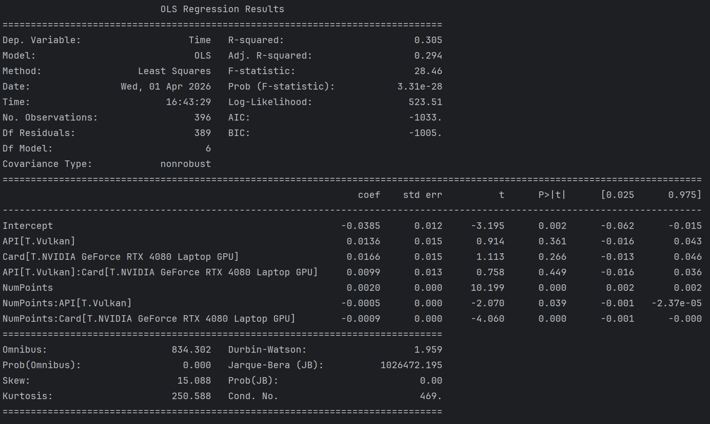
Results
Generation multiple linear regression test results

Slide 19
Results
These results indicate that hypothesis one is true, as whilst there is no initial significant statistical difference between Vulkan and OpenGL, there is a statistically significant difference as they scale. OpenGL is faster initially, with Vulkan scaling better. The chosen GPU has no statistically significant affect on the APIs performance for Generation.

Slide 20
Results
Clipping results

Slide 21
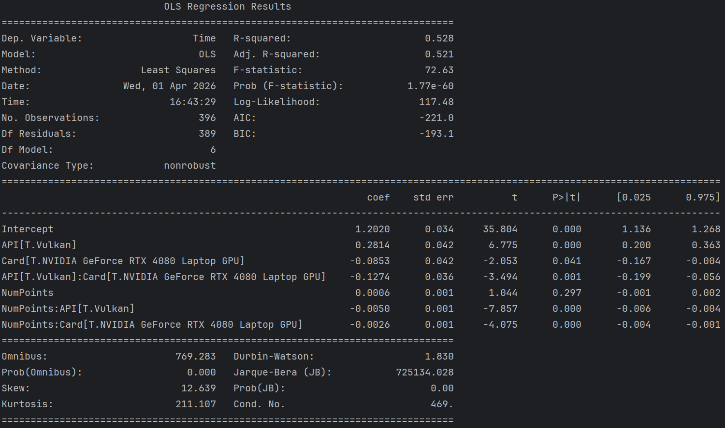
Results
Clipping multiple linear regression test results

Slide 22
Results
The results indicate that hypothesis two is true. This is because there is a statistically significant difference in both the initial performance differences, and in how they scale. Initially, OpenGL outperforms Vulkan, however at scale, Vulkan outperforms OpenGL. The GPU also makes a statistically significant difference as Vulkan on the 4080 laptop GPU outperforms OpenGL much faster than on the 3070 GPU.

Slide 23
Implications
For generation, the results have shown that Vulkan is not always faster than OpenGL.
At a lower point set, OpenGL consistently outperformed Vulkan. Whilst the 4080 GPU did show a trend of performing better than OpenGL at a lower point set then the 3070 GPU, this was still around 60 points suggesting that for cell generation, if you are using a relativity low point set of less than 60, OpenGL is the better choice for your application.
This could be due to a poor implementation of Vulkan, but research suggests that Vulkan was designed to take advantage of the parallelism of modern GPUs, so Vulkan performing better when parallelism matters more is logical. If you plan for a higher point set, and want scalability in your application, Vulkan is the recommended choice.

Slide 24
Implications
Hypothesis two was proven true, as there was a significant statistical performance difference between OpenGL and Vulkan.
Vulkan on the 4080 GPU was very close in performance to OpenGL even in the beginning and performed better after around 5 points. The 3070 GPU took longer, consistently outperforming OpenGL past around 65 points.
The implications of this are that the 4080, and possibly other more modern hardware, is more performant with Vulkan than older hardware such as the 3070. Because of this, Vulkan is the preferred choice for clipping if you are targeting more modern hardware or are building for scalability.

Slide 25
Broader Impacts
From a sustainability perspective, this may help developers make more informed decisions about what API best suites their application that uses Voronoi fracturing as this may lead to reduced execution times, which could reduce energy consumption.
However, due to DVFS, lower execution time may result in increased power usage and as such, developers must still be wary of energy efficiency when selecting an API. A higher or lower power usage will also affect the temperature of the computer, which could lead to health and safety issues, such as reduced computer lifespan, if the temperature of the computer increases too much.
Environmentally, if power usage changes, this could have an impact as lower power usage would help to reduce global warming, whereas the contrary would increase it. As a result of this, the sustainability impact of this paper is limited.

Slide 26
Broader Impacts
There is a social impact, as developers can make more informed decisions on the most performant API for their application based on scale and target hardware. This may increase accessibility as a wider range of hardware may be able to run their application, reducing hardware barriers for users and making a societal impact.
Professionally, this paper allows developers to make a more informed decision by demonstrating that API performance varies based on hardware and scale for Voronoi fracturing. This could help reduce development time and improve optimisation, which would have a commercial impact as it could save costs, and increase a products usability if it is better optimised as a result of this paper.
As a result, this paper contributes to more efficient and responsible engineering in any applications that make use of Voronoi fracturing.

Slide 27
Broader Impacts
Ethically, this paper was low risk and did not violate GDPR. This paper followed the Bcs code of conduct by not making any claims beyond the scope of this experiment. This paper does not have a negative ethical impact but has a positive one as it helps developers to better understand which API is best suited to their application.
Legally, this paper has ensured that all external libraries and algorithms used are legal for this paper to use, as they are in the public domain, or require crediting to use.
The repository the artefact is under is the Apache 2.0 license, making it open source as requirements are met such as crediting the original. This has a legal impact, as anyone is free to use, modify, or distribute the repository, which may help others learn or create Voronoi fracturing based applications

Slide 28
Recommendations
After analysing the results, this paper would recommend Vulkan when building for scalability, or more modern hardware, whereas this paper would recommend OpenGL if working with older hardware and with a lower point set, ideally below 60.
If performance is not a concern, OpenGL is the recommendation due to the ease of setup, as this paper found difficulty with the implementation of Vulkan, and found that the time to implement was much longer than OpenGL.
To conclude, Vulkan is best for scale and modern hardware, OpenGL for low parallelism, ease of use, and older hardware.

Slide 29
Conclusion
With destruction effects growing in usage, complexity and scale, there is a need to optimise applications to account for this. Whilst many methods have been tried to optimise the algorithms themselves, there has not been much research into optimising what graphics API best performs such destruction techniques.
This paper opted to focus on Voronoi fracturing as it is a widely used destruction technique in many applications. The artefact produced accurately answers this question by testing the execution time for a compute shader executed by both Vulkan and OpenGL to perform clipping and cell generation.
This test was repeated 145 times to ensure accuracy and performed on 2 computers to ensure results were not specific to one computer. However, the number of GPU's tested were not large enough to completely answer the question. This paper contributed to the field by demonstrating that API performance is not absolute but dependent on the scale and used GPU, challenging the common assumption that Vulkan universally outperforms OpenGL.
The limitations to this work prove there are improvements to be made to definitively answer the question of How does the execution time of OpenGL compare to Vulkan for a 3D Voronoi fracturing of a mesh?

Slide 30
Thank you for listening!

